Slide 1
ASIA-PACIFIC TRAINING CURRICULUM ON GENDER STATISTICS
Calculating gender statistics for SDG monitoring

Slide 2
Become familiar with the methodological details of how to calculate specific gender indicators across the 3 pillars of the SDGs
Understand the key concepts, methods of computation and practical examples associated with the calculation of gender-related SDG indicators
Understand the importance of incorporating gender statistics across all the SDGs
Learn how to use gender data to monitor progress with some indicators that are not necessarily gendered in the official SDG monitoring framework
1
Learning Objectives

Slide 3
2
The SDG indicator framework

Slide 4

















Uneven coverage of gender in the SDG framework
Across the 17 SDGs, GENDER has been mainstreamed, BUT unevenly
According to the initial indicator set (prior to the 2020 revision):
Gender-specific: Directly address gender-related issues
  53 out of 232 indicators are gender-specific
  53 clustered around 6 out of 17 SDGs
Gender-sparse: Direct mention of sex-disaggregation in very few indicators
  5 out of remaining 11 SDGs
Gender-blind: No gender angle in any of the indicators
  6 of the remaining SDGs
Uneven distribution of gender across SDG Global Indicator Framework
SDG Global indicator framework
Gender-sensitive
Gender-sparse
Gender-blind

Slide 5
Mainstreaming gender across the 3 pillars of the SDGs
3

Slide 6
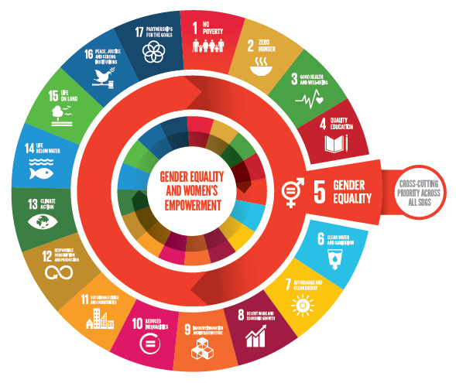
Mainstreaming gender across the 3 pillars of the SDGs
Without gender equality the SDGs cannot be achieved
3 pillars of SDGs
  Economic
  Social
  Environmental
Need to mainstream gender across the 3 pillars to achieve the SDGs
Image source: UN Women. 2018. Turning promises into action.

Slide 7
4
Monitoring the SDGs from a gender perspective

Slide 8
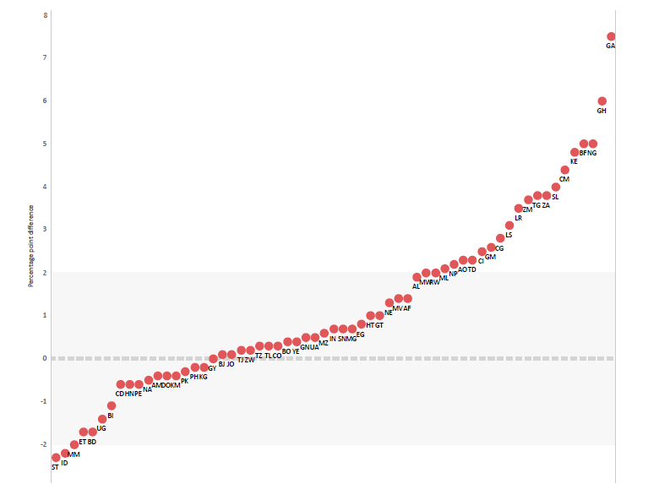
Monitoring the SDGs from a gender perspective
Gender gap among individuals aged 15–49 living in slums, 2007 or later
At least 85 SDG indicators are gender relevant
Not all explicitly mention sex, women or men, or specific gender issues
BUT they can be GENDERED
  Disaggregating data by sex or related variables
  E.g. Proportion of urban population living in slums, informal settlements or inadequate housing, disaggregated by sex
Image source: Azcona, Duerto, Bhatt (forthcoming)

Slide 9
5
Calculating gender statistics for SDG indicators

Slide 10
Indicator methodology
Indicator 5.4.1: Proportion of time spent on unpaid domestic and care work, by sex
Definition
Proportion of TIME spent on unpaid domestic and care work in 24 hours
Data for several days is averaged to produce an estimate for average time spent in ONE day
Unpaid domestic and care work activities are SERVICES for OWN-USE of household or family members
  E.g. childcare for neighbours does not count
Own-use
production
of goods
Own-use
provision
of services
Unpaid domestic services
Unpaid
caregiving services
Own-use
production
work
CLASSIFYING TIME USE ACTIVITIES
International Classification of Activities for Time Use Statistics (ICATUS)

Slide 11
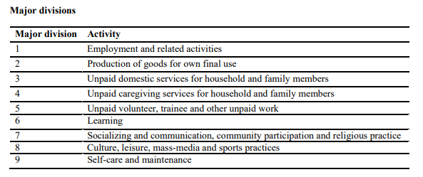
Indicator methodology
Indicator 5.4.1: Proportion of time spent on unpaid domestic and care work, by age, sex and location
ICATUS classification of activities
International Classification of Activities for Time Use Statistics (ICATUS)
  Standard classification for time-use statistics
  Groups activities in a meaningful way
  Activities in Major Divisions 3 & 4 needed for this indicator
  Major divisions are further divided into sub-activities

Slide 12
Indicator methodology
Indicator 5.4.1: Proportion of time spent on unpaid domestic and care work, by age, sex and location
Data source
Diary-based methods
  type of activities in which people engage
  how much time people spend on these activities
  time of the day when individuals undertake certain activities
  activities occurring simultaneously.
Stylized retrospective questions
  Ask respondents to recall how much time they usually spend performing a certain activity
Diaries are the only instruments that record simultaneous activities

Slide 13
Indicator methodology
Indicator 5.4.1: Proportion of time spent on unpaid domestic and care work, by age, sex and location
Data source
Time diary with open time intervals

Slide 14
Indicator methodology
Indicator 5.4.1: Proportion of time spent on unpaid domestic and care work, by age, sex and location
Data source
Example of a filled 24-hour time diary
Watching over sleeping child is unpaid care work that may not be captured if respondent is asked only about primary activities

Slide 15
Indicator methodology
Indicator 5.4.1: Proportion of time spent on unpaid domestic and care work, by age, sex and location
Light time-use diary
Data source
Activity categories |  | 04:00-05:00 |  |  |  | 05:00-06:00 |  |  |  | 06:00-07:00 |  |  |  | 07:00-08:00
Sleeping and resting | 1
Eating | 2
Personal care | 3
School (also homework) | 4
Work as employed | 5
Own business work | 6
Framing | 7
Animal rearing | 8
Fishing | 9
Shopping/getting services | 10
Weaving, sewing | 11
Cooking | 12
Domestic work | 13
Care for children/adult/elderly | 14
Commuting | 15
Traveling | 16
Watching TV | 17
Reading | 18
Sitting with family | 19
Exercising | 20
Social visits | 21
Practicing hobbies | 22
Other, specify | 23

Slide 16
Indicator methodology
Indicator 5.4.1: Proportion of time spent on unpaid domestic and care work, by age, sex and location
Coding of response
  Done by trained staff
  Responses are coded based on standard guidelines
  To code simultaneous activities, expert coders are needed
  See UNSD guidelines on coding: https://unstats.un.org/unsd/publication/SeriesF/SeriesF_93E.pdf

Slide 17
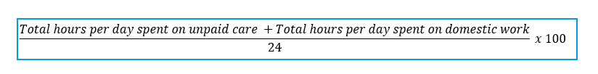
Indicator methodology
Indicator 5.4.1: Proportion of time spent on unpaid domestic and care work, by age, sex and location
Computation method
  Data is expressed as a proportion of time in a day
  Weekly data averaged over 7 days of the week to obtain daily average
  Data over seasons is averaged to produce daily average
  Once response is coded as per ICATUS, this indicator can be calculated as follows:
Data disaggregation:
  Sex: women and girls/men and boys
  Age: (recommended groups) 15+, 15-24, 25-44, 45-54, 55-64 and 65+
  Location: urban/rural (following national definitions given the lack of international definition)

Slide 18
Indicator methodology
Indicator 5.5.2: Proportion of women in managerial positions
Definition
Proportion of women in total number of persons employed in managerial positions
Captures information about women employed in government, large enterprises and institutions, in:
  Decision-making roles
  Management roles
Two measures can be used:
  Share of women in TOTAL management
  Share of women in SENIOR and MIDDLE management
CLASSIFICATION INTO JUNIOR, MIDDLE AND SENIOR MANAGEMENT
International Standard Classification of Occupations (ISCO-08)

Slide 19
Indicator methodology
Indicator 5.5.2: Proportion of women in managerial positions
Key concepts
International Standard Classification of Occupations (ISCO-08)
  Organizes jobs into groups based on tasks and duties
  Refer to Major Category 1 to calculate this indicator
  Further divided into sub-major and minor categories
Minor Categories
Major Group 1: Managers
11: Chief executives, senior officials and legislators
111: Chief executives and Senior officials
1111: Legislators
e.g. City councillor, government minister, mayor
1112: Senior government officials
e.g. Ambassadors, police chief constable, secretary-general
1113: Traditional chiefs and heads of village
e.g. Village chief, village head
Major Category 1
ISCO-08 Classification of managers
Sub-major categories

Slide 20

Indicator methodology
Indicator 5.5.2: Proportion of women in managerial positions
Computation method
1) To calculate the share of women in total management (junior level + middle level + senior level):
2) To calculate the share of women in middle and senior management:

Slide 21
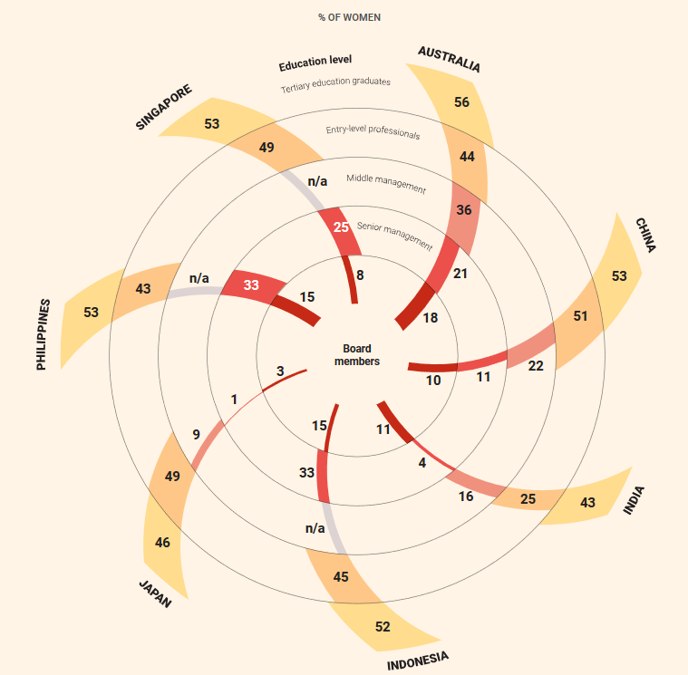
Indicator methodology
Indicator 5.5.2: Proportion of women in managerial positions
  - Where does managerial level matter?
  Wage gaps, by managerial level
  Proportion of women researchers, by managerial level
  Proportion of women in XXX occupation, by managerial level
  Proportion of time spent on unpaid care and domestic work, by employment status and managerial level
  Proportion of women who have a say in making large household purchases, by employment status and managerial level
Image source: Turning Promises into Action, 2018

Slide 22
Indicator methodology
Indicator 8.10.2: Proportion of adults (15 years and older) with an account at a bank or other financial institution
Definition
- The number of adults (ages 15 or older) who report having an account (by themselves or together with someone else) at a bank or another type of financial institution or personally using a mobile money service in the past 12 months compared to the total number of adults (ages 15 or older)
Why is it important?
- Having a bank account gives people access to credit
- Collateral to start a new business, large purchases, rebuild in cases of loss

Slide 23
Indicator methodology
Indicator 8.10.2: Proportion of adults (15 years and older) with an account at a bank or other financial institution
Key concepts
Other financial institution: owning, receiving money or paying bills through accounts at a credit union, microfinance institution, cooperative, the post office, having a debit card in their own name.
Mobile money: respondents who personally use GSM Association (GSMA) Mobile Money for the Unbanked (MMU) services to pay bills or to send or receive money; or respondents receiving wages, government transfers, or payments through a mobile phone.

Slide 24
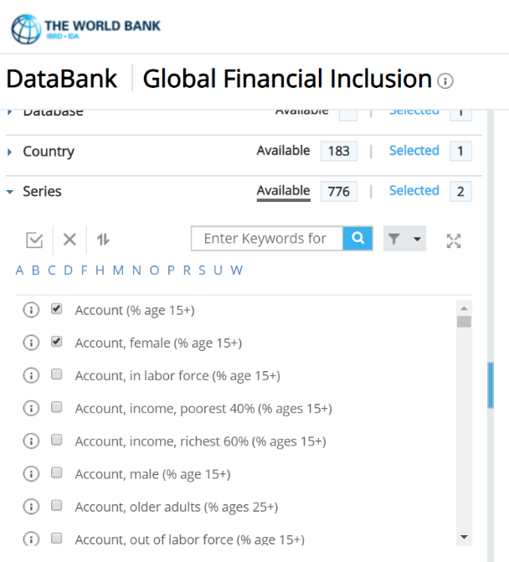
Indicator methodology
Indicator 8.10.2: Proportion of adults (15 years and older) with an account at a bank or other financial institution
Snapshot of Findex Database
Data sources
- Individual-level surveys (Other surveys at household level may measure the access to finance through another member of the household which may overestimate financial inclusion)
  Global Findex (Asset ownership and financial inclusion) – recommended source
  Asset ownership surveys
  Modules on asset ownership in other standardized surveys

Slide 25
Indicator methodology
Indicator 8.10.2: Proportion of adults (15 years and older) with an account at a bank or other financial institution
Computation method
Use the following formula to calculate the estimates for this indicator:
Don’t forget to sex disaggregate
Number of adults (ages 15+) who report having an account (by themselves or together with someone else) at a bank or another type of financial institution or personally using a mobile money service in the past 12 months.
X 100
Total number of adults (ages 15+)

Slide 26
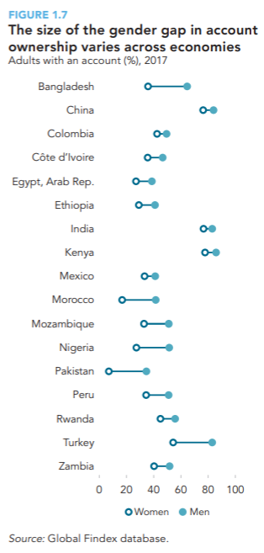
Indicator methodology
Indicator 8.10.2: Proportion of adults (15 years and older) with an account at a bank or other financial institution
Disaggregation of data:
Sex disaggregation is needed to identify gender gaps in account ownership
Gender gaps exist across countries

Slide 27

Indicator methodology
Indicator 5.2.1: Proportion of ever-partnered women and girls aged 15 years and older subjected to physical, sexual or psychological violence by a current or former intimate partner in the previous 12 months, by form of violence and by age
Definition
- The percentage of ever-partnered women and girls aged 15 years and older who have experienced physical, sexual or psychological violence by a current or former intimate partner, in the previous 12 months.

Slide 28
Indicator methodology
Indicator 5.2.1: Proportion of ever-partnered women and girls aged 15 years and older subjected to physical, sexual or psychological violence by a current or former intimate partner in the previous 12 months, by form of violence and by age
Violence against women (VAW): any act of gender-based violence that results in, or is likely to result in physical, sexual or psychological harm or suffering to women including threats of such acts, coercion or arbitrary deprivation of liberty, whether occurring in public or in private life
Ever-partnered: People who have ever been married or in a union. In surveys, one can identify if a woman is ever-partnered as: Age of first cohabitation < or = to current age, or ever in a relationship (even if not in a formal union)
Intimate partner violence: It includes an abuse perpetrated by a current or former partner within the context of marriage, cohabitation or any other formal or informal union
3 types of violence (for this indicator):
  Physical violence
  Sexual violence
  Psychological violence

Slide 29
Indicator methodology
Indicator 5.2.1: Proportion of ever-partnered women and girls aged 15 years and older subjected to physical, sexual or psychological violence by a current or former intimate partner in the previous 12 months, by form of violence and by age
Key concepts
- A non-exhaustive list of acts under each type of violence (see syllabus for more comprehensive list):
Acts of physical violence
Slapping
Pushing, shaking, throwing something
Twisting arm or pulling hair
Punching with fist or something that could hurt
Kicking, dragging, beating up
Choking or burning
Acts of sexual violence
Physically forcing you to have sexual intercourse
Physically forcing you to perform unwanted sexual acts
Forcing you with threats or any other way to perform sexual acts
Acts of psychological violence
Saying or doing something to humiliate you in front of others
Threatening to hurt or harm you or someone close to you
Insulting you
Making you feel bad about yourself

Slide 30
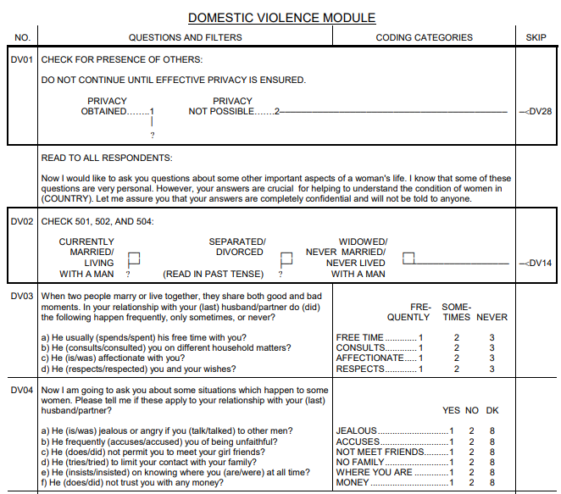
Indicator methodology
Indicator 5.2.1: Proportion of ever-partnered women and girls aged 15 years and older subjected to physical, sexual or psychological violence by a current or former intimate partner in the previous 12 months, by form of violence and by age
Data sources
Specialized national population-based surveys dedicated to measure VAW
International household surveys (with a module on experience of violence by women). For instance:
  Demographic and Health Surveys (DHS)
  Multiple Indicator Cluster Surveys (MICS)
A module on domestic violence is sometimes added to DHS & MICS

Slide 31
Indicator methodology
Indicator 5.2.1: Proportion of ever-partnered women and girls aged 15 years and older subjected to physical, sexual or psychological violence by a current or former intimate partner in the previous 12 mo., by form of violence and by age
Key considerations
Data collection must adhere to ethical and safety standards agreed internationally to avoid putting interviewees and interviewers at greater risk of violence.
The indicator calls for reporting on physical, sexual and psychological violence. However, there is no international definition for psychological violence so, in practice, physical and sexual are used for global reporting. Countries are encouraged, however, to pursue the collection of data on psychological violence
Although the indicator targets women 15 years and older, most surveys including related questions cover age groups 15–49 only. Thus, the narrower age group is currently used for global reporting.
Data should only be obtained from specialized population-based household surveys dedicated to measuring violence against women and international population-based household surveys that include a separate module on experience of violence by women.
Although administrative data from health, police, courts, justice and social services, among other services used by survivors of violence, can provide information on violence against women and girls, these do not provide prevalence data, but rather incidence data or service-use data.

Slide 32
Indicator methodology
Indicator 5.2.1: Proportion of ever-partnered women and girls aged 15 years and older subjected to physical, sexual or psychological violence by a current or former intimate partner in the previous 12 months, by form of violence and by age
Computation method
- Physical violence
No. of ever-partnered women and girls (aged 15 years and above) who experienced physical violence by a current or former intimate partner in the previous 12 months
X 100
No. of ever-partnered women and girls (aged 15 years and above) in the population
- Sexual violence
No. of ever-partnered women and girls (aged 15 years and above) who experienced sexual violence by a current or former intimate partner in the previous 12 months
X 100
No. of ever-partnered women and girls (aged 15 years and above) in the population
- Psychological violence
No. of ever-partnered women and girls (aged 15 years and above) who experienced psychological violence by a current or former intimate partner in the previous 12 months
X 100
No. of ever-partnered women and girls (aged 15 years and above) in the population

Slide 33
Indicator methodology
Indicator 5.2.1: Proportion of ever-partnered women and girls aged 15 years and older subjected to physical, sexual or psychological violence by a current or former intimate partner in the previous 12 months, by form of violence and by age
Data-disaggregation variables that are specific to this indicator include:
marital/partnership status,
relationship to the perpetrator (e.g. current or former intimate partner)
frequency of violence

Slide 34
Indicator methodology
Indicator 5.1.1: Whether or not legal frameworks are in place to promote, enforce and monitor equality and non-discrimination on the basis of sex
Definition
Based on an assessment of the Government’s efforts for putting in place legal frameworks that promote, enforce and monitor gender equality
Measures whether a legal framework that advances gender equality is in place.

Slide 35
Indicator methodology
Indicator 5.1.1: Whether or not legal frameworks are in place to promote, enforce and monitor equality and non-discrimination on the basis of sex
Key concepts
Legal frameworks: defined broadly to encompass laws, mechanisms and policies/plans to ‘promote, enforce and monitor’ gender equality.
- Promote: Legal frameworks that ‘promote’ are those that establish women’s equal rights with men and enshrine non-discrimination on the basis of sex.
- Enforce and monitor: Legal frameworks that ‘enforce and monitor’ are directed at the realization of equality and non-discrimination and implementation of laws, such as policies/plans, establishment of enforcement and monitoring mechanisms, and allocation of financial resources.

Slide 36
Indicator methodology
Indicator 5.1.1: Whether or not legal frameworks are in place to promote, enforce and monitor equality and non-discrimination on the basis of sex
Computation method
NSOs and National Women’s Machineries carry out the assessment of country’s laws, mechanisms and policies/plans
Letter/questionnaire is sent by UN Women, World Bank and OECD Development Centre to Ministries of Women and NSOs
Ministries and NSOs review and assess preliminary findings, and send any changes/comments back to UN Women, World Bank and OECD Development Centre
Final answers arrived at after process of validation/exchange of correspondence with Ministries and NSOs
45 yes/no questions under 4 areas of law
Area | Focus | Number of questions
1 | Overarching legal frameworks and public life | 12
2 | Violence against women | 12
3 | Employment and economic benefits | 10
4 | Marriage and family | 11

Slide 37
Indicator methodology
Indicator 5.1.1. Whether or not legal frameworks are in place to promote, enforce and monitor equality and non-discrimination on the basis of sex
Examples of questions relating to promotion, enforcement and monitoring
Computation method
For each area of law, questions assess whether the legal framework:
  Promotes gender equality
  Enforces/monitors gender equality
Area 1: Overarching legal frameworks and public life
Promote
- Is the customary law invalid if it violates Constitutional provisions on equality?
- Are there quotas for women in national parliament?
Enforce/Monitor
- Does the law establish a specialized independent body tasked with receiving complaints of discrimination based on gender?
Promote
Is there legislation that specifically addresses sexual harassment?
Enforce/Monitor
Are there budgetary commitments by government entities for the implementation of legislation addressing violence against women?
Area 3:
Employment and economic benefits
Promote
Does the law mandate nondiscrimination on the basis of gender in employment?
Enforce/Monitor
Is childcare publicly provided or subsidized?
Area 4:
Marriage and family
Promote
Do women and men have equal rights to enter marriage (i.e., consent) and initiate divorce?
Enforce/Monitor
Is marriage under the legal age void or voidable?
Area 2: Violence against women

Slide 38
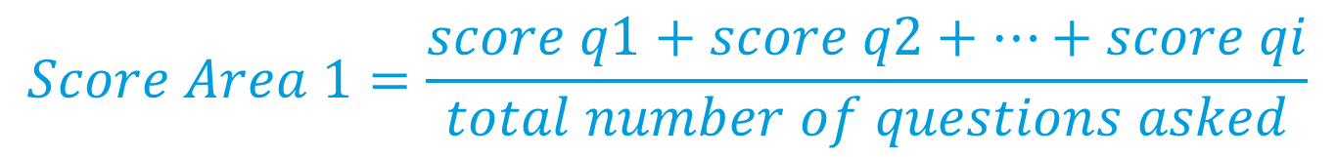
Indicator methodology
Indicator 5.1.1: Whether or not legal frameworks are in place to promote, enforce and monitor equality and non-discrimination on the basis of sex
Computation method
- “Yes” answers are coded as 1; “No” answers are coded as 0.
- All questions must get an answer.
- The only two exceptions (which could get N/A) are:
Example of scoring
Area of law | No. of questions | No. of questions coded as 1 (Yes) | Final percentage score (No. of questions coded 1/ Total number of questions)*100
Overarching legal frameworks and public life | 12 | 8 | (8/12)*100
Violence against women | 12 | 6 | (6/12)*100
Employment and economic benefits | 10 | 8 | (8/12)*100
Marriage and family | 11 | 7 | (7/11)*100
1. If customary law is a valid source of law under the Constitution, is it invalid if it violates constitutional provisions on equality or non-discrimination?
2. If personal law is a valid source of law under the Constitution, is it invalid if it violates constitutional provisions on equality or non-discrimination?
- Scoring of response:
$$Score Area 1=\frac{score q1+score q2+…+score qi}{total number of questions asked}$$

Slide 39
Indicator methodology
Indicator 5.5.1 (b): Proportion of seats held by women in local governments
Definition
Proportion of positions held by women in local government
- Measured as the number of elected seats held by women in deliberative bodies of local government over the total elected seats in deliberative bodies in local government and presented as a percentage

Slide 40
Indicator methodology
Indicator 5.5.1 (b): Proportion of seats held by women in local governments
Key concepts
Local government: (According to 2008 SNA, Para 4.129, 4.145) Comprises institutional units whose fiscal, legislative and executive authority extends over the smallest geographical areas distinguished for administrative and political purposes
  Usually a result of decentralization, transferring political, fiscal or administrative powers from the central government to subnational units
  What constitutes local government is defined by a country’s national and legal framework
  Central government powers enable local governments to regulate and/or run certain government functions on their own and are the key criteria for differentiating between what constitutes local government and what constitutes simple state or public administration implementing state policies or delivering services at local level.
Deliberative bodies: Formal entities with decision-making power, including the ability to issue by-laws, on a range of local aspects of public affairs.
Elected positions: (as opposed to appointed positions) selected in local elections, voters cast ballots for
the person, persons or political party. Includes both elected persons who competed on openly contested seats and on reserved seats or through a candidate quota.

Slide 41
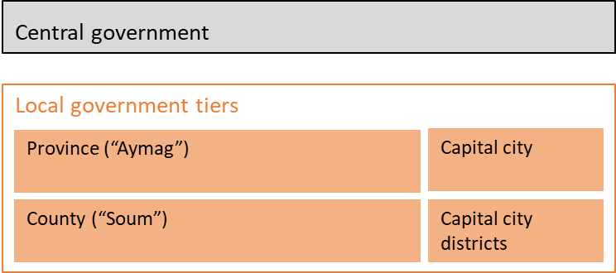
Indicator methodology
Indicator 5.5.1 (b): Proportion of seats held by women in local governments
Structure of government, Mongolia

Slide 42
Indicator methodology
Indicator 5.5.1 (b): Proportion of seats held by women in local governments
Data source
Administrative data produced by Electoral Management Body (EMB) tasked with organizing elections at the local level
  E.g. who won the elections
  Sex of the winning candidate
Data table in the generic data request form
- UN Women and UN regional commissions send this request form to National EMB

Slide 43
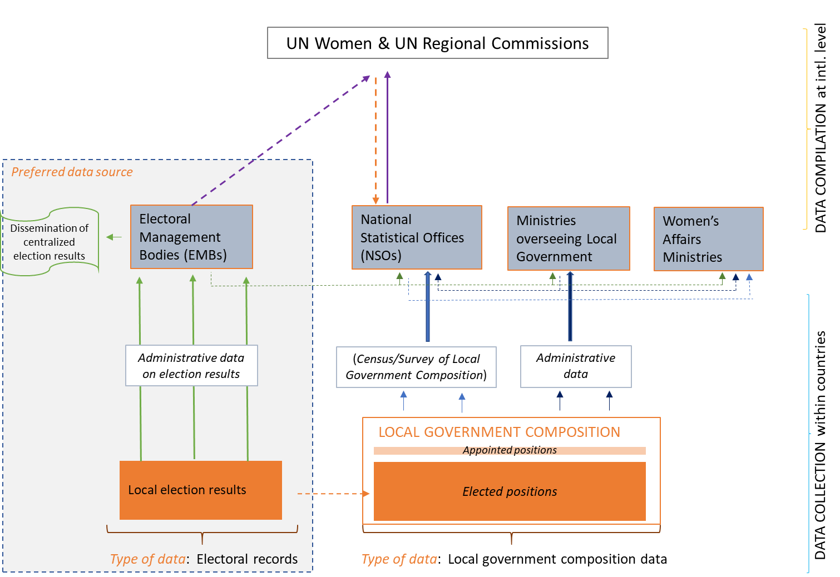
Indicator methodology
Indicator 5.5.1 (b): Proportion of seats held by women in local governments
Figure: Sources and flow of data

Slide 44
Indicator methodology
Indicator 5.5.1 (b): Proportion of seats held by women in local governments
What if the country does not have an EMB?
Public administration data:
  For instance, government payroll or other registries
  Often broader than elected positions (additional processing needed)
Surveys/Censuses using local government units as units of observation:
  Conducted by NSOs or line ministries
  Include local government surveys, establishment surveys, municipality surveys

Slide 45
Indicator methodology
Indicator 5.c.1: Proportion of countries with systems to track and make public allocations for gender equality and women’s empowerment
Definition
- Whether or not government has systems in place to track and publish budget allocations for gender equality throughout the public finance management cycle.
  This is an indicator of characteristics of the fiscal system
  It is not an indicator of quantity or quality of finance allocated for gender equality
The indicator measures three criteria:
The intent of a government to address gender equality and women’s empowerment by identifying if it has related programmes/policies and resource allocations.
If a government has planning and budgeting tools to track resources for gender equality and women’s empowerment throughout the public financial management cycle.
Transparency, by identifying if a government has provisions to make allocations for GEWE publicly available.

Slide 46
Indicator methodology
Indicator 5.c.1: Proportion of countries with systems to track and make public allocations for gender equality and women’s empowerment
Key concepts
Public financial management system: all aspects of a country’s budget process – both upstream (strategic planning, medium-term expenditure framework, annual budgeting) and downstream (revenue management, monitoring and evaluation, audits and oversight).
Systems to track: processes and procedures to plan, approve, allocate and monitor public expenditures at the national and sectoral level. The system in place is overseen by a governmental body, in most cases the Ministry of Finance.

Slide 47
Indicator methodology
Indicator 5.c.1: Proportion of countries with systems to track and make public allocations for gender equality and women’s empowerment
Data source
- A set of questions is sent to the Ministry of Finance, or added to OECD’s survey on budget practices and procedures
- Several questions are used to evaluate if each of the 3 criteria is met:
- Criterion 1 (3 questions)
- Criterion 2 (7 questions)
- Criterion 3 (3 questions)
Questions | Concept definitions
Question 1.1. Are there policies and/or programmes of the government designed to address well identified gender equality goals, including those where gender equality is not the primary objective | Programmes or policies that specifically target only women and girls e.g. prenatal care programme, national action plan on gender equality
Question 1.2. Do these policies and/or programmes have adequate resources allocated within the budget, sufficient to meet both their general objectives and their gender equality goals? | Programmes or policies that are designed to address well-identified gender equality goals are allocated sufficient resources to cover the costs of meeting those goals from funding that is included in the budget
Question 1.3. Are there procedures in place to ensure that these resources are executed according to the budget? | Procedures established in law or regulations
EXAMPLE

Slide 48
Indicator methodology
Indicator 5.c.1: Proportion of countries with systems to track and make public allocations for gender equality and women’s empowerment
Scoring of response:
Yes responses coded as 1
No responses coded as 0
Requirements per criterion
A country will satisfy Criterion 1 | if it answers “Yes” to 2 out of 3 questions in Criterion 1
A country will satisfy Criterion 2 | if it answers “Yes” to 4 out of 7 questions in Criterion 2
A country will satisfy Criterion 3 | if it answers “Yes” to 2 out of 3 questions in Criterion 3
CLASSIFICATION | STATUS
“FULLY MEETS REQUIREMENS” | Meets all 3 of the criteria
“APPROACHES REQUIREMENTS” | Meets one or two criteria
“DOES NOT MEET REQUIREMENTS” | Does not meet any criteria

Slide 49
Indicator methodology
Indicator 7.1.2: Proportion of population with primary reliance on clean fuels and technology, by sex
Definition
The number of people using clean fuels and technologies for cooking, heating or lighting, divided by total population reporting any cooking, heating or lighting activity, expressed as a percentage
New WHO guidelines indicate that the combination of certain types of fuel with types of technology used for cooking or heating (e.g. stove, lamp, open flame, etc.) might result in higher levels of air pollutants. However, most households do not compile information on technologies yet

Slide 50
Indicator methodology
Indicator 7.1.2: Proportion of population with primary reliance on clean fuels and technology, by sex
Key concepts
Clean fuel: A fuel is defined as ‘clean’ based on the emission rate targets and specific fuel recommendations included in the WHO guidelines for indoor air quality: household fuel combustion. Unprocessed coal and kerosene (among other types of fuels) are not considered clean.
Household air pollution: Air pollution generated by household fuel combustion, leading to indoor air pollution, and contributing to ambient air pollution.
Classification criteria for unclean and clean cooking fuels, as per WHO Guidelines on indoor air quality
Clean cooking fuel
Electricity
Liquified Petroleum Gas (LPG)
Unclean cooking fuel
Solid biomass fuel (e.g. wood, animal dung, crop wastes, charcoal)
Kerosene
Natural gas
Biogas
Solar cooker
Open fires

Slide 51
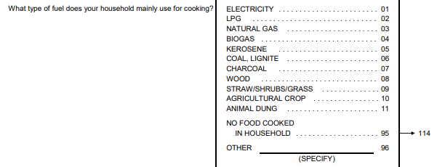
Indicator methodology
Indicator 7.1.2: Proportion of population with primary reliance on clean fuels and technology, by sex
Data source
Household surveys
  Demographic and Health Surveys (DHS)
  Multiple Indicator Cluster Surveys (MICS)
  World Health Surveys (WHS)
  Other reliable and nationally representative surveys
Excerpt of DHS questions on type of cooking fuel
World Bank (with support from Energy Sector Management Assistance Program (ESMAP) has launched a Global Survey on Energy Access
  Based on Multi-Tier Framework approach
  Goes beyond traditional binary measurements of energy access
  Captured multidimensional nature of energy access

Slide 52
Indicator methodology
Multi-Tier Framework Survey for Measuring Energy Access 2017-2018
Fuel Type | Activity the fuel is used for
 | Lighting | Cooking | Heating | Cooling | Fire starter/ ignition | Boiling water | Home-based income activity | Other, specify
LPG/cooking gas
Wood purchased
Wood collected
Charcoal
Solar
Kerosene
Piped natural gas
Coal/lignite
Animal waste/dung
Crop residue/plant biomass
Saw dust
Coal briquette
Biomass briquette
Electric
Pellets/processed biomass/wood chips
Biogas (from animal waste or dung)
Ethanol
Garbage/plastic

Slide 53
Indicator methodology
Indicator 7.1.2: Proportion of population with primary reliance on clean fuels and technology, by sex
Computation method
- For the total population
$$\frac{\text{Number} \text{of} \text{people} \text{living} \text{in} \text{households} \text{using} \text{clean} \text{fuels} \text{and} \text{technologies} \text{for} \text{cooking}\text{, }\text{heating} \text{and} \text{lighting} }{\text{Total} \text{population} \text{reporting} \text{any} \text{cooking}\text{, }\text{heating} \text{or} \text{lighting} \text{takes} \text{place} \text{in} \text{their} \text{households}}\text{ × 100}$$
Data disaggregated by sex
  This indicator can be disaggregated by sex, as it has a gender angle
Women’s estimate
$$\frac{\text{Number} \text{of} \text{women} \text{living} \text{in} \text{households} \text{using} \text{clean} \text{fuels} \text{and} \text{technologies} \text{for} \text{cooking}\text{, }\text{heating} \text{and} \text{lighting} }{\text{Total} \text{number} \text{of} \text{women} \text{reporting} \text{any} \text{cooking}\text{, }\text{heating} \text{or} \text{lighting} \text{takes} \text{place} \text{in} \text{their} \text{households}} \text{×}\text{ 100}$$
Men’s estimate
$$\frac{\text{Number} \text{of} \text{men} \text{living} \text{in} \text{households} \text{using} \text{clean} \text{fuels} \text{and} \text{technologies} \text{for} \text{cooking}\text{, }\text{heating} \text{and} \text{lighting} }{\text{Total} \text{number} \text{of} \text{men} \text{reporting} \text{any} \text{cooking}\text{, }\text{heating} \text{or} \text{lighting} \text{in} \text{their} \text{households} } \text{×}\text{ 100}$$

Slide 54
Indicator methodology
Indicator 7.1.2: Proportion of population with primary reliance on clean fuels and technology, by sex
Computation method
Data disaggregated by activity:
Cooking
$$\frac{Number of people living in households using clean fuels and technologies for cooking }{Total number of people reporting any cooking taking place in their households}×100$$
Heating
$$\frac{Number of people living in households using clean fuels and technologies for heating}{Total number of people reporting any heating taking place in their households}×100$$
Lighting
$$\frac{Number of people living in households using clean fuels and technologies for lighting }{Total number of people reporting any lighting available in their households}×100$$

Slide 55
Indicator methodology
Indicator 11.1.1: Proportion of urban population living in slums, informal settlements or inadequate housing, by sex
Definition
Number of people living in slums, informal settlements or inadequate households divided by the city population, multiplied by 100
Slums represent one of the most extreme forms of deprivation and exclusion and are a critical factor for the persistence of poverty and exclusion
Slums are located in an URBAN SETTING only
Slum inhabitants lack one or more of the following
1. Lack of access to improved water source
2. Lack of access to improved sanitation facilities
3. Lack of sufficient living area
4. Lack of housing durability
5. Lack of security of tenure

Slide 56
Indicator methodology
Indicator 11.1.1: Proportion of urban population living in slums, informal settlements or inadequate housing, by sex
Key concepts
Access to improved water services
  Water source protected from outside contamination (in particular from fecal matter)
  Less than 50% of households have improved water supply
  At least 20 litres, per person per day
  Water source within acceptable collection time
A person lacks BASIC water service if she/he:
Does NOT have access to an improved water source
Has access to an improved source but must travel 30 MINUTES OR MORE to collect water from the water source
The list of improved sources of water includes:
water piped-in to dwelling, plot or yard; public
tap/stand pipe service with no more than 5 households
protected spring
rain water collection
bottled water, if secondary source is also improved
bore hole/tube well
protected dug well

Slide 57
Indicator methodology
Indicator 11.1.1: Proportion of urban population living in slums, informal settlements or inadequate housing, by sex
Key concepts
Access to improved sanitation
  Excreta disposal system is adequate
  Not shared between more than two households
A person lacks BASIC sanitation if she/he:
Does NOT have access to improved sanitation facilities
Facilities are shared between more than two households
The list of improved sanitation facilities include:
flush/pour-flush toilets or latrines connected to a sewer,
septic tank or pit;
ventilated improved pit latrine;
pit latrine with a slab or platform that covers the pit entirely; and,
composting toilets/latrines.

Slide 58
Indicator methodology
Indicator 11.1.1: Proportion of urban population living in slums, informal settlements or inadequate housing, by sex
Key concepts
Access to sufficient living area
  No more than three people share the same habitable room
  A dwelling is classified as OVERCROWDED if more than three people use the same room for sleeping

Slide 59
Indicator methodology
Indicator 11.1.1: Proportion of urban population living in slums, informal settlements or inadequate housing, by sex
Key concepts
Access to durable housing:
  House in a non-hazardous location
    Not located on or near toxic waste
    Not located in a flood plain or a steep slope
    Not located in a dangerous right of way (rail, highway, airport or power lines)
  Has a permanent and adequate structure
    Permanent building material for the walls, roof and floor
    Compliance with building codes
    Dwelling is not in a dilapidated state

Slide 60
Indicator methodology
Indicator 11.1.1: Proportion of urban population living in slums, informal settlements or inadequate housing, by sex
Key concepts
Access to security of tenure
  Security of tenure: Status established through statutory or customary law or informal or hybrid arrangements, that safeguard the household members against forced evictions
  Data for measuring security of tenure is not widely available so it is often dropped from the calculation of the slum indicator

Slide 61
Indicator methodology
Indicator 11.1.1: Proportion of urban population living in slums, informal settlements or inadequate housing, by sex
Key concepts
Criteria defining slums, informal settlements and inadequate housing
 | Slums | Informal settlements | Inadequate housing
Access to water | X | X | X
Access to sanitation | X | X | X
Sufficient living area, overcrowding | X |  | X
Structural quality, durability and location | X | X | X
Security of tenure | X | X | X
Affordability |  |  | X
Accessibility |  |  | X
Cultural adequacy |  |  | X

Slide 62
Indicator methodology
Indicator 11.1.1: Proportion of urban population living in slums, informal settlements or inadequate housing, by sex
Computation method
- Slum/informal settlements households (SISH):
$$\frac{Number of people living in SISH households in urban areas}{Urban population} ×100$$
-Disaggregated by sex
Women’s estimate
$$\frac{Number of women living in SISH households in urban areas}{Total number of women living in urban areas} ×100$$
Men’s estimate
$$\frac{Number of men living in SISH households in urban areas}{Total number of men living in urban areas} ×100$$

Slide 63
Indicator methodology
Indicator 5.a.1. Proportion of total agricultural population with ownership or secure rights over agricultural land, by sex
Definition
The share of people among the agricultural population with ownership or tenure rights over agricultural land
It is calculated using the agricultural population of women and men as reference population and shows how many men to women own land
- The extent to which women are disadvantaged in ownership/tenure rights over agricultural land. It focuses on the agricultural population with land ownership/tenure rights, and it shows how many of them are women

Slide 64
Indicator methodology
Indicator 5.a.1: Proportion of total agricultural population with ownership or secure rights over agricultural land, by sex
Key concepts
Agricultural land
  arable land under temporary crops (i.e., crops with less than a one-year growing cycle)
  arable land under temporary meadows and pastures (i.e., cultivated with herbaceous forage crops for mowing or pasture)
  arable land that is temporarily fallow (due to crop rotation systems or temporary unavailability for planting)
  land under permanent crops
  land under permanent meadows and pastures
Adult agricultural population
  Person should be an adult
    18 years or older (for global monitoring)
    National legal definition for adult should be used for country-specific monitoring
  Person should belong to an agricultural household
    At least one member is mainly engaged in agriculture over the past 12 months

Slide 65
Indicator methodology
Indicator 5.a.1: Proportion of total agricultural population with ownership or secure rights over agricultural land, by sex
Key concepts
Land owner: A person is classified as land owner if:
  If the person is listed as ‘OWNER’ or ‘holder’ on a certificate
  or
  If the person has the RIGHT TO SELL agricultural land
                or
  If the person has the RIGHT TO BEQUEATH agricultural land

Slide 66
Indicator methodology
Indicator 5.a.1. Proportion of total agricultural population with ownership or secure rights over agricultural land, by sex
Data source
Surveys that interview both men and women are best suited, such as:
  Household Budget Surveys (HBS)
  Living Standard Measurement Surveys (LSMS)
  Labor Force Surveys (LFS)
  Demographic and Health Surveys (DHS)
  Multiple Indicator Cluster Surveys (MICS)
  Population and Housing Census
  Agricultural surveys

Slide 67
Indicator methodology
Indicator 5.a.1: Proportion of total agricultural population with ownership or secure rights over agricultural land, by sex
Data source
Food and Agricultural Organization (FAO): Minimum set of 5 questions
  These questions must be included into standard surveys
  Information to be collected at individual level
Q1. Do you own any agricultural land, either alone or jointly with someone else?
Q2. Is there an ownership document for any of the agricultural land you own? (for enumerators
Q3. Is your name is listed as an owner on any of the ownership documents?
Q4. Do you have the right to sell any of the agricultural land you own, either alone or jointly with someone else?
Q5. Do you have the right to bequeath any of the agricultural land you own, either alone or jointly with someone else?

Slide 68
Gender-Environment Indicators
Indicator 5.a.1: Proportion of total agricultural population with ownership or secure rights over agricultural land, by sex
Computation method
- Sub-indicator 5.a.1 (a): Measure of prevalence for total population
$$\frac{\text{No}\text{. }\text{of} \text{people} \text{in} \text{agricultural} \text{population} \text{with} \text{ownership} \text{or} \text{tenure} \text{rights} \text{over} \text{agricultural} \text{land}}{\text{Total} \text{agricultural} \text{population}} \text{×}\text{100}$$
Sub-indicator 5.a.1 (b): Measure of gender parity
$$\frac{\text{No}\text{. }\text{of} \text{women} \text{in} \text{agricultural} \text{population} \text{with} \text{ownership} \text{or} \text{tenure} \text{rights} \text{over} \text{agricultural} \text{land}}{Total no. of agricultural population with ownership or tenure rights over agricultural land} \text{×}\text{100}$$

Slide 69
Additional statistics on Gender-Environment
Women and the environment
- Women are more vulnerable to disasters, as they often have worse jobs, less assets, are more likely to be poor and to live in unsafe housing.
- Post disasters, women are less likely to be decision-makers, so new structures do not respond to their needs.
- Women depend more than men on environmental resources. Less likely to own land, they often collect fodder, firewood and water. Climate change affects their time use and livelihoods.
- Women in Asia are largely in charge of agricultural work. They often engage in selling veggies and fish in markets. Climate change put this at stake.

Slide 70
Additional statistics on Gender-Environment
Gender-environment indicators: proposals by UNEP & IUCN
SDG
indicators
UNEP-IUCN 19 indicators on gender-environment
93 Enviro. indicators

Slide 71
Additional statistics on Gender-Environment
Gender-environment indicators: Asia-Pacific proposal
Asia-Pacific set
SDG
indicators
UNEP-IUCN 19 indicators on gender-environment
93 Enviro. indicators

Slide 72
Additional statistics on Gender-Environment
G-E Nexus: Priority areas for Asia-Pacific
A. Land and biodiversity
B. Natural resources including food, energy and water
C. Climate change and disasters
D. Sustainable consumption, production and waste
E. Health, well-being and sanitation
F. Environmental decision-making

Slide 73
Additional statistics on Gender-Environment
Where do we currently stand?
- EGM on Disaster Statistics (one day on gender)
  >> priority indicators identified
  >> further work to look at methodology
  - EM on gender and environment statistics
    To bring visibility to the connections between gender and environment statistics in A-P
    To bring together policymakers and statisticians
    To discuss the way forward
    Findings:
      Significant gap areas
      New indicators needed for gap areas
      Data collection to begin in pilot countries to populate these indicators

Slide 74
9
Key takeaways

Slide 75
Key takeaways
Gender statistics must be integrated throughout the SDG indicator framework across all three pillars of sustainable development: economic, social and environmental.
Along with compiling data for gender-specific indicators, it is important to sex-disaggregate other indicators, across all three pillars.
Time-diaries are best suited to capture the simultaneity of activities when calculating estimates for Indicator 5.4.1: Proportion of time spent on unpaid domestic and care work, by age, sex and location.
When calculating the estimates for Indicator 5.2.1, proportion of ever-partnered women and girls subjected to violence, make the distinction between type of violence and perpetrator of violence. Indicator 5.2.1 only focuses on violence perpetrated by an intimate partner in the 12 months preceding the survey date.
No internationally agreed methodology exists for psychological violence, but countries are still encouraged to pursue the compilation of related data.

Slide 76
Key takeaways
Use individual-level household survey data to calculate the estimate for prevalence of intimate partner violence.
For the calculation of women’s representation in local governments, exclude women who have been appointed or nominated by government officials from higher-ranking tiers of government. Only women who have been elected should be included.
For the calculation of Indicator 7.1.2, proportion of population with primary reliance on clean fuels and technology, only the primary fuel used in the house is considered. In the case that the respondent reports using different fuels for cooking, heating and lighting, the main type of fuel used for cooking is counted.
For the calculation of Indicator 11.1.1, Proportion of urban population living in slums, informal settlements or inadequate housing, only the urban population is considered.
For the calculation of Indicator 5.a.1 (a), Proportion of total agricultural population with ownership or secure rights over agricultural land, women who belong to households which are engaged in agricultural practices should be considered part of the adult agricultural population.

Slide 77
Thank You

